Slide 1
Correlation
Adwait

Slide 2
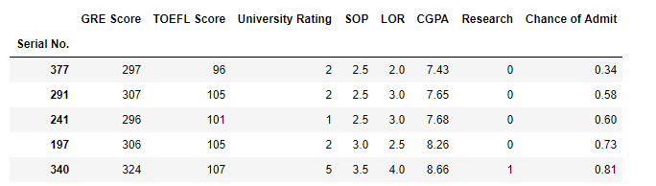
Data
GRE Score, TOEFL Score etc are quantitative or numeric variables.
There are other type of variables – categorical.
Research has only two possible values. It is called binary or dichotomous.
Discrete and Continuous
Nominal and Ordinal
Notes:
source images :
https://appleinsider.com/articles/17/05/17/google-adds-smart-replies-to-gmail-for-ios-based-on-machine-learning
https://communityrising.kasasa.com/bots-better-marketing/amazon-recommends/
https://images.techhive.com/images/article/2013/08/mylist-100050912-large.jpg

Slide 3
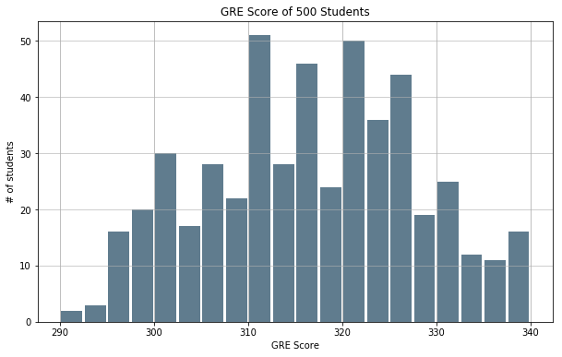
Visualize variable
A set of observations for a variable.
You meet someone randomly, without any prior information, which score is likely?
316

Slide 4
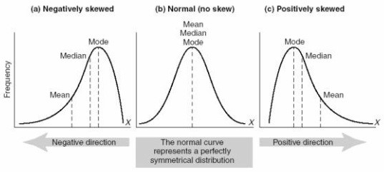
Mean Model
The simplest model.
Depends on the how variable is distributed.
What are we trying to do?
Notes:
Ref : https://www.isobudgets.com/probability-distributions-for-measurement-uncertainty/

Slide 5
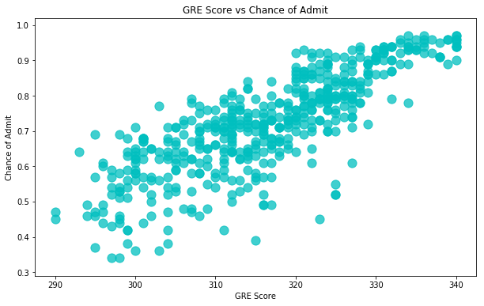
GRE vs Chance of Admit
scatterplot
GRE score has influence on chance of admit
bivariate relationship
Tells us about the strength of the relationship
summarized using a straight line. Linearity

Slide 6
About Correlation
The term "correlation" refers to a mutual relationship or association between two variables.
Correlation can help in predicting one quantity from another.
Correlation is used as a foundation for many other modelling techniques.
Pearson is the most widely used correlation coefficient. Pearson correlation measures the linear association between continuous variables.

Slide 7
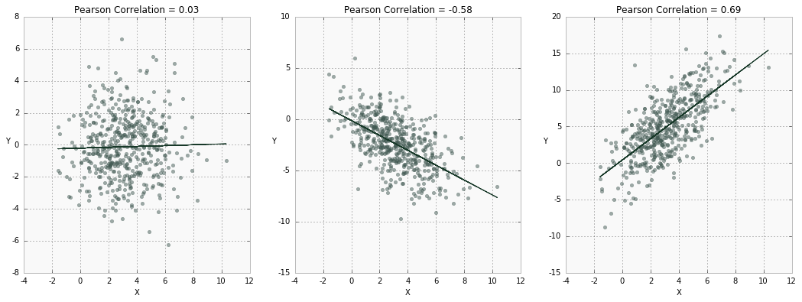
Strength of Association
Notes:
Ref : https://www.datascience.com/learn-data-science/fundamentals/introduction-to-correlation-python-data-science

Slide 8
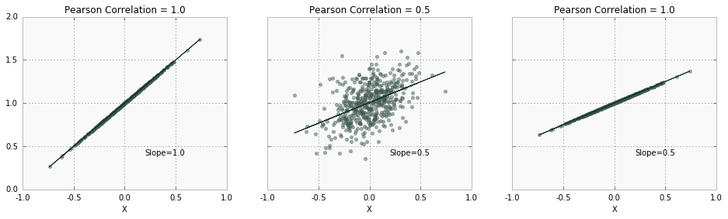
Strength of Association
Notes:
Ref : https://www.datascience.com/learn-data-science/fundamentals/introduction-to-correlation-python-data-science

Slide 9
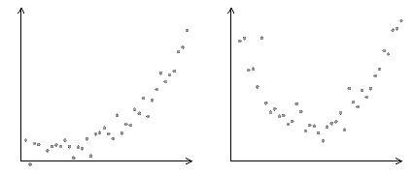
Linear vs non-linear
We don’t know if there is linear relationship.
We don’t know strength of this linear relationship.
So, we visualize the data or assume there is a linear relationship.

Slide 10
“Being single is boring. Being in a relationship is complicated.”
Anonymous

Slide 11
Thanks!

